Slide 1


Machine learning for physics and astronomy chapter 7
Viviana Acquaviva

Slide 2
a quick dip into unsupervised learning: Clustering and K-Means
w many many thanks to
Ashwin Satyanarayana
who has taught clustering in my class many times,
and has drafted several of these slides!

Slide 3


Clustering in Today’s world
Notes:
News source from Google News Entertainment, 5/17/2023; photo on the right from Adobe Stock

Slide 4
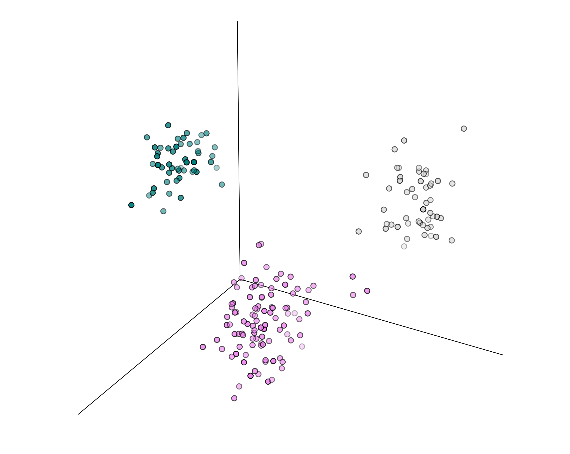
What is Clustering?
In general, a grouping of objects such that the objects in a group (cluster) are similar (or related) to one another and different from (or unrelated to) the objects in other groups
A clustering scheme is
successful if inter-cluster distances are large and intra-cluster distance are small.
max
min
Visualization inspiration
credit: Loren Rhodes

Slide 5
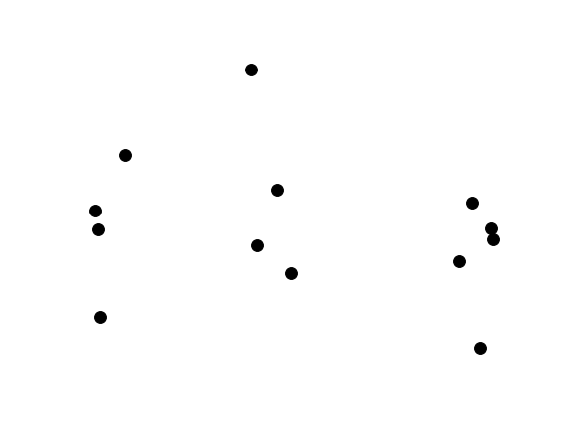
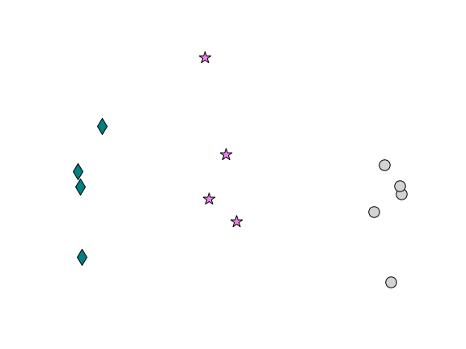
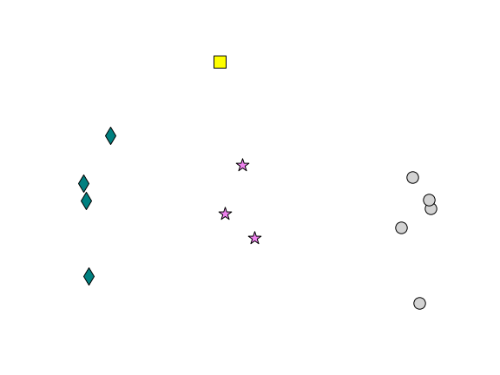
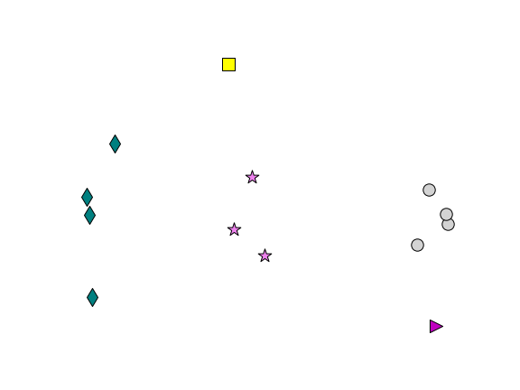
THE Notion of a Cluster can be Ambiguous
Data points
3 clusters
4 clusters
5 clusters

Slide 6
Types of Clustering
A clustering is a set of clusters
Important distinction between hierarchical and partitional sets of clusters:
Partitional Clustering
A division of data objects into subsets (clusters) such that each data object is in exactly one subset
Hierarchical clustering
A set of nested clusters organized as a hierarchical tree

Slide 7
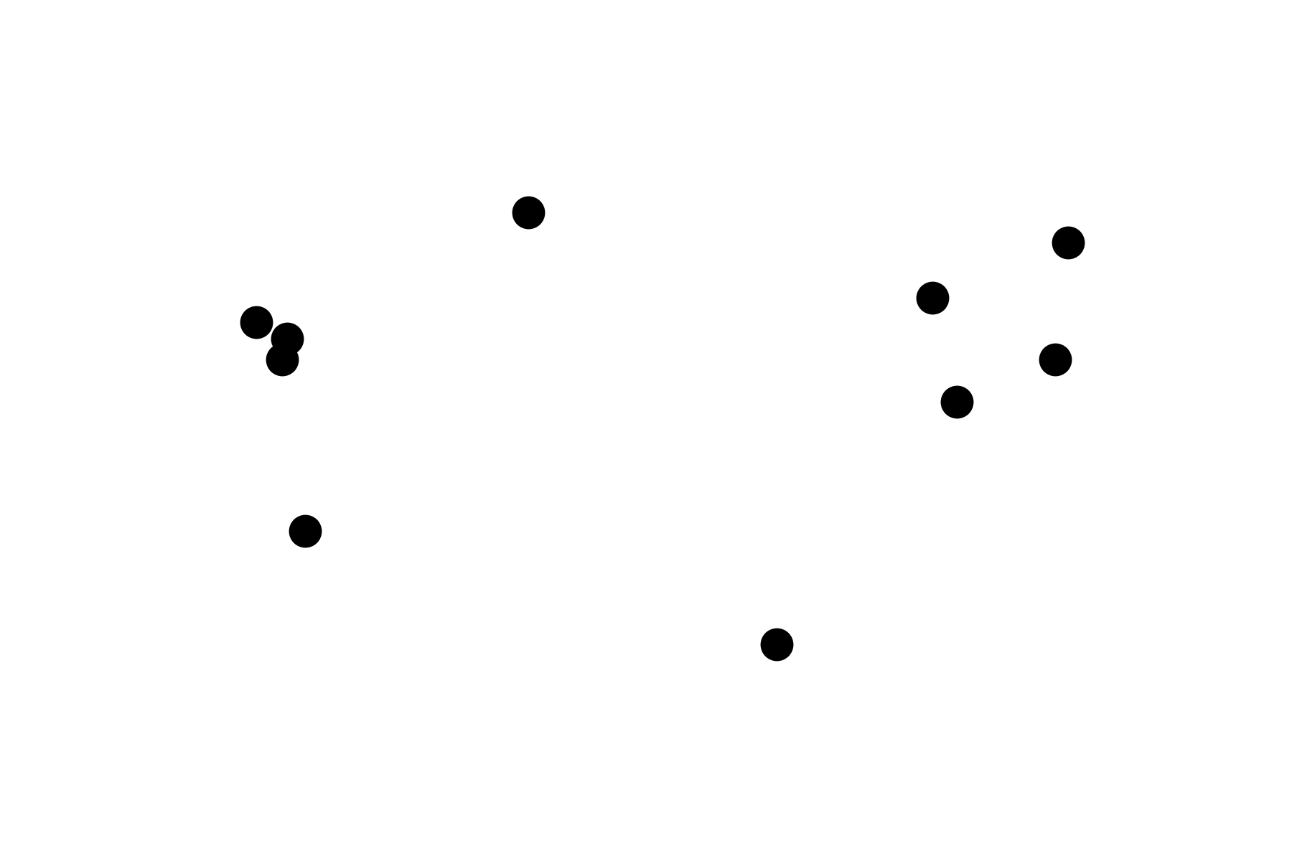
Partitional Clustering
n = 2
Data points
n = 3
n = 4

Slide 8
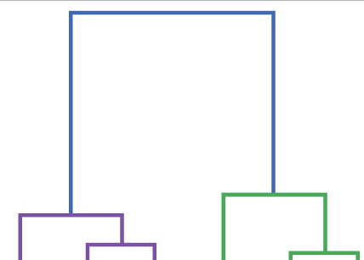
Hierarchical Clustering
Data points
Clustering
Dendrogram
representation
of clustering

Slide 9
Clustering AS an optimization problem
Goal: find clusters that minimize or maximize an objective function.
Solution: Enumerate all possible ways of dividing the points into clusters and evaluate the `goodness' of each potential set of clusters by using the given objective function. (NP Hard)
Can have global or local objectives.
Hierarchical clustering algorithms typically have local objectives
Partitional algorithms typically have global objectives
A variation of the global objective function approach is to fit the data to a parameterized model.
The parameters for the model are determined from the data, and they determine the clustering
E.g., Mixture Models assume that the data is a ‘mixture' of statistical distributions.

Slide 10
K-means

Slide 11
K-means Clustering
Partitional clustering approach
Number of clusters, K, must be specified
Each cluster is associated with a centroid (mean point of all objects in the cluster)
Each point is assigned to the cluster with the closest centroid
The objective is to minimize the sum of distances of the points to their respective centroid

Slide 12
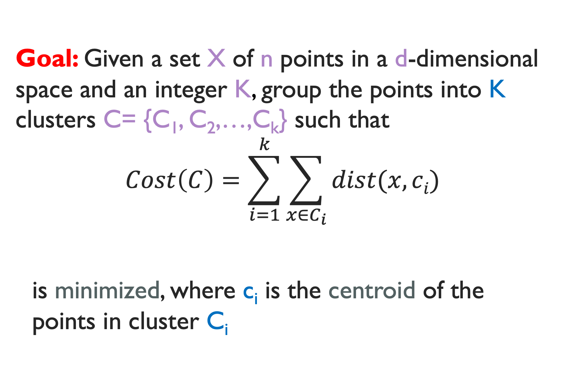
K-means Clustering
Goal: Given a set X of n points in a d-dimensional space and an integer K, group the points into K clusters C= {C₁, C₂,…,C_{k}} such that
$$Cost\left(C\right)=\sum_{i=1}^{k}{\sum_{x∈C_{i}}{dist(x,ci)}}$$
is minimized, where c_{i} is the centroid of the points in cluster C_{i}

Slide 13
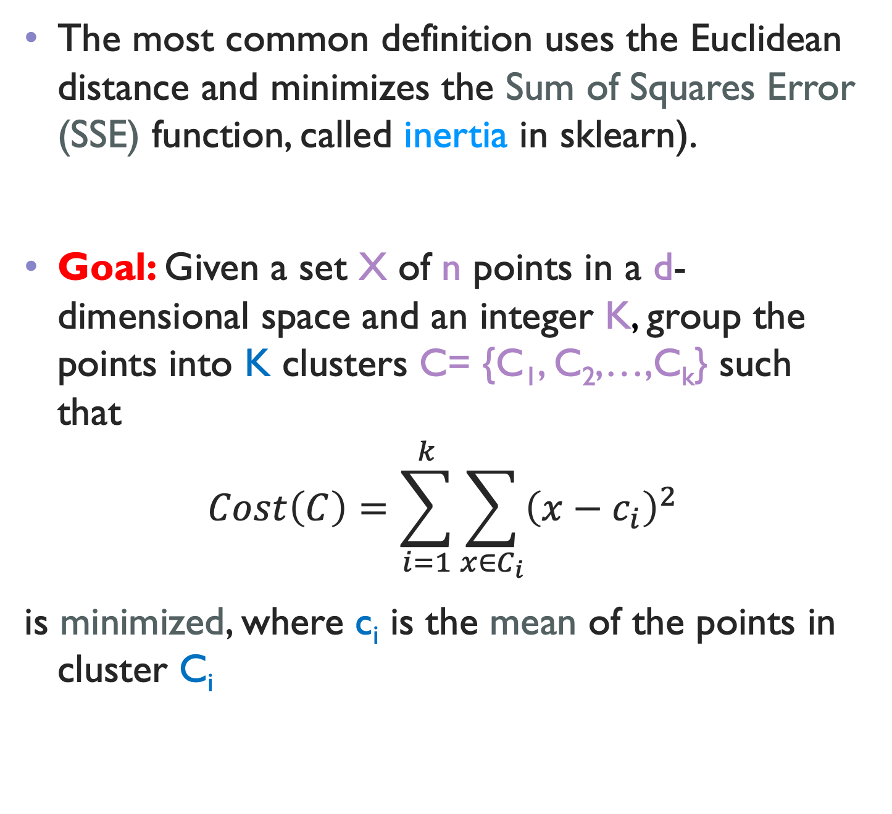
K-means Clustering
The most common definition uses the Euclidean distance and minimizes the Sum of Squares Error (SSE) function, called inertia in sklearn).
Goal: Given a set X of n points in a d-dimensional space and an integer K, group the points into K clusters C= {C₁, C₂,…,C_{k}} such that
$$Cost\left(C\right)=\sum_{i=1}^{k}{\sum_{x∈C_{i}}{{\left(x−c_{i}\right)}^{2}}}$$
is minimized, where c_{i} is the mean of the points in cluster C_{i}

Slide 14
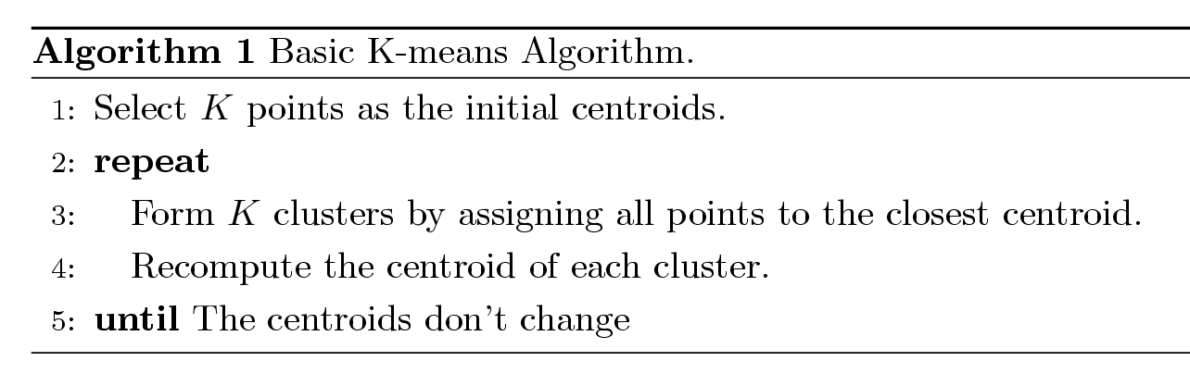
K-means Algorithm
Pseudocode:

Slide 15
Problem - Initialization
Initial centroids are often chosen randomly, and clusters produced vary from one run to another.
Solution 1: Do multiple runs and select the clustering with the smallest error
Solution 2: Select original set of points by methods other than random . E.g., pick the most distant (from each other) points as cluster centers (K-means++ algorithm)

Slide 16
K-means Algorithm – Convergence
K-means will converge for common similarity measures mentioned above.
Most of the convergence happens in the first few iterations.
Often the stopping condition is changed to ‘Until relatively few points change cluster membership’
Complexity is O( n * K * I * d )
n = number of points, K = number of clusters, I = number of iterations, d = dimensionality of feature space
In general, a fast and efficient algorithm

Slide 17
Limitations of K-means
You need to specify the number of clusters in advance
(although there are ways to find it empirically,
e.g. the elbow method).
K-means has problems when clusters have different sizes, densities, or have non-globular shapes.
K-means has problems when the data contains outliers.

Slide 18
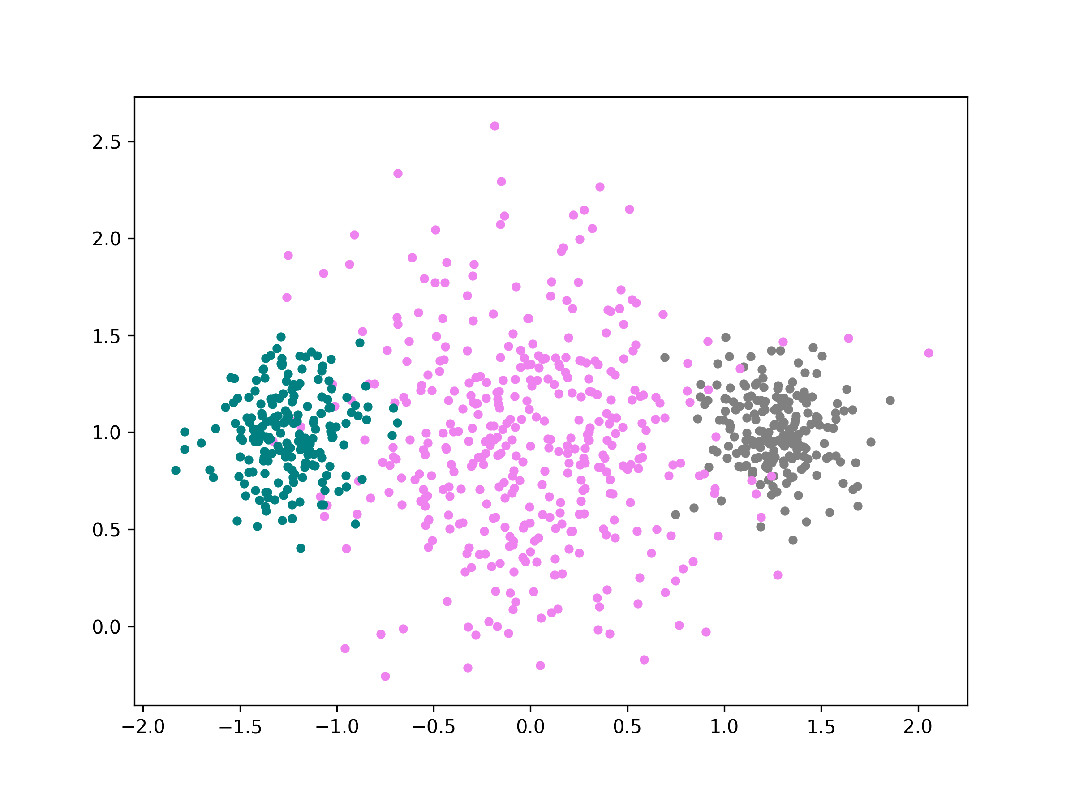
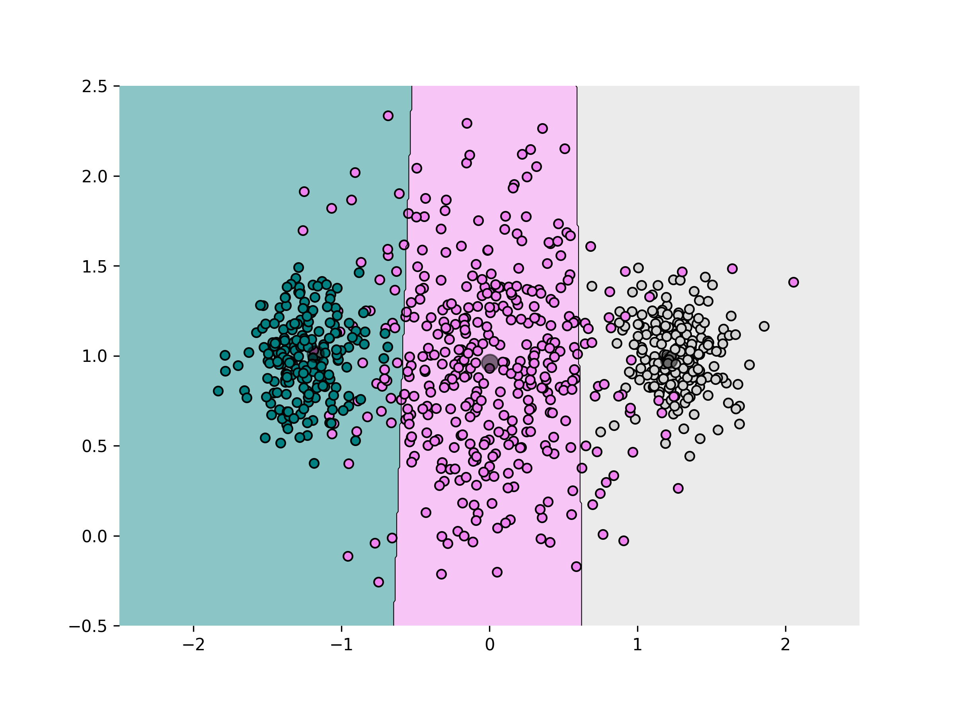
Limitations of K-means: Different Sizes/densities
Original Points
K-means (3 Clusters)

Slide 19
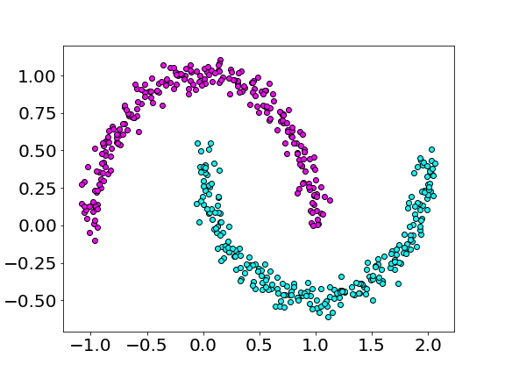
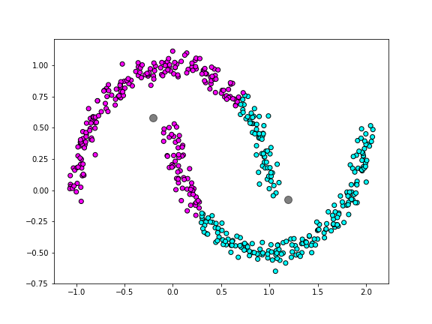
Limitations of K-means: Non-globular Shapes
Original Points
K-means (2 Clusters)

Slide 20
other methods may help for those cases https://scikit-learn.org/stable/modules/clustering.html

Slide 21
Let’s play: https://www.naftaliharris.com/blog/visualizing-k-means-clustering/

Slide 22
THE elbow method
The elbow method is an empirical technique to find the optimal number of clusters for an algorithm like k-means.
The basic idea is to run the clustering scheme for many values of k and plot the inertia (the cost function).
Of course, the inertia decreases as k increases, but we can try to find the “elbow” of the curve, the point where there is the maximum change in slope (or the maximum decrease of inertia per unit increment in k).
The problem with the elbow method (and in general, the bane of clustering methods) is that if the assumptions on the clustering are not valid (for example, if you apply it to data where clusters exist but are not convex), results are meaningless.

Slide 23
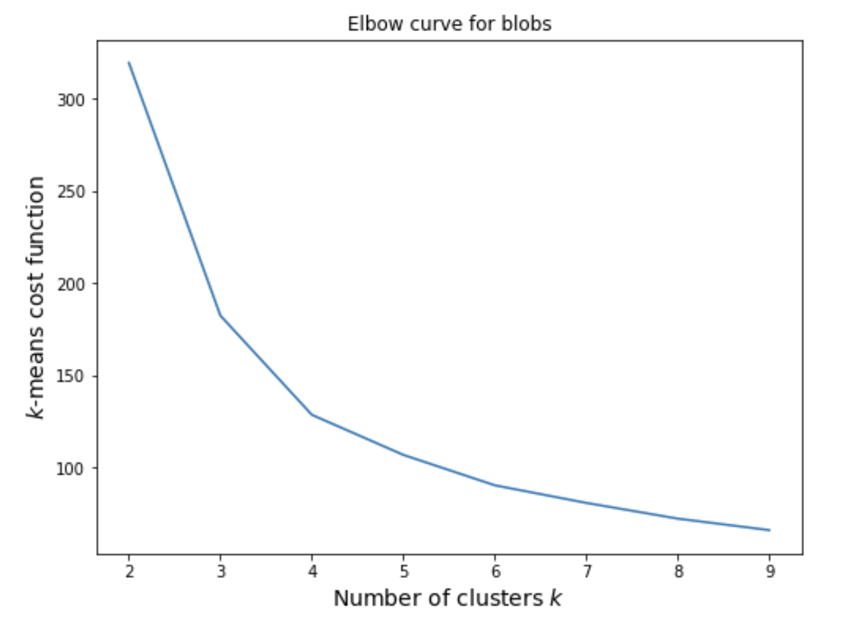
how does the elbow look like?

Slide 24
density-based clustering
Density-based clustering algorithms like DBSCAN find clusters by identifying higher-density areas in the data.
Because of this, they are ok with arbitrary shapes, and they will automatically find the number of clusters for us.
This sounds amazing, but remember, there is no free lunch, not even free cold brew (other than at CCA).
The way DBSCAN operates is regulated by hyperparameters: the proximity threshold 𝜖, which characterizes the density of clusters, and the minimum number of samples in a cluster.
Finding the optimal 𝜖 is not easy (just like the optimal k in k means!) because we can’t easily tune hyperparameters in unsupervised algorithms.

Slide 25
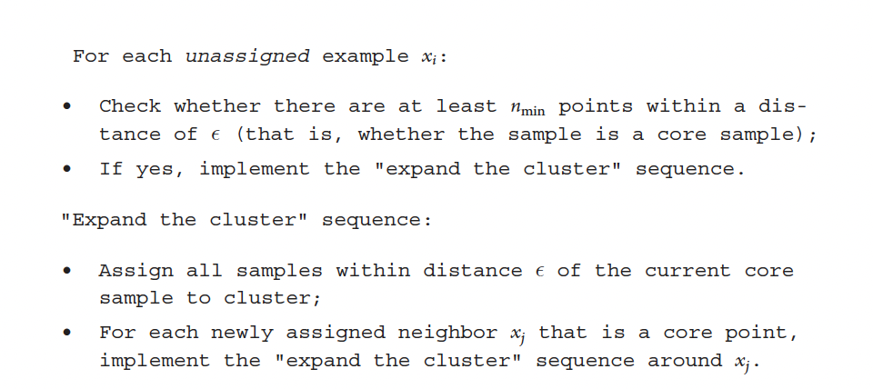
DBSCAN pseudocode
On the bright side, DBSCAN is quite useful to find outliers; it will
categorize samples as “core”, “edge”, and “other”.

Slide 26
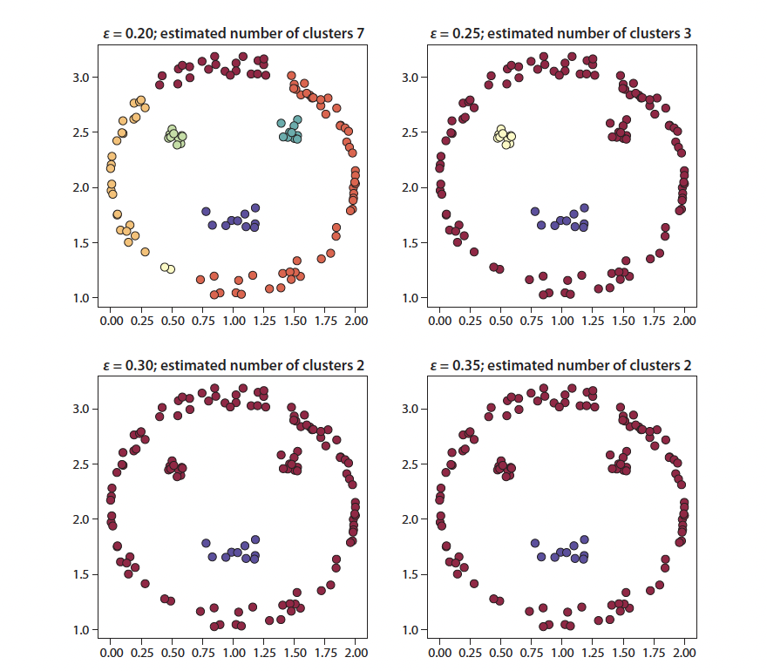
dbscan for smiley face and different values of 𝜖

Slide 27
generative models
Generative models are a very powerful class of models that use a mathematical model to learn the distribution from which our samples are drawn.
Of course, there is no guarantee that they learn the ”true” distribution: this depends greatly on the framework used and on the characterstics of the data (we can think of data as a learning set, but we don’t learn a property for each object, we learn their global properties).
This matters because we can then sample from that learned distribution, generating new samples that are similar to the ones we have.

Slide 28
gaussian mixture models
Gaussian Mixture Models are among the simplest generative models; often quoted as a clustering method, but they are much more than that!
They attempt to describe the data as a superposition of Gaussian distributions and to learn the mean and covariances of those.
Gaussian Mixtures are still convex, but compared to k-means, can learn clusters that are of different sizes, elongated, not just globular, and rotated with respect to the axes (the features).

Slide 29
gaussian mixture models
They afford us a probabilistic interpretation, so they provide not just a clustering assignment, but the probability that each sample belongs to each cluster.
This is great: we have an assessment of the confidence of our clustering assignment.
We can also use criteria like the BIC (Bayesian Information Criterion) to derive the optimal number of Gaussian components in our data (note that this is not the same as the number of clusters in the data!)

Slide 30
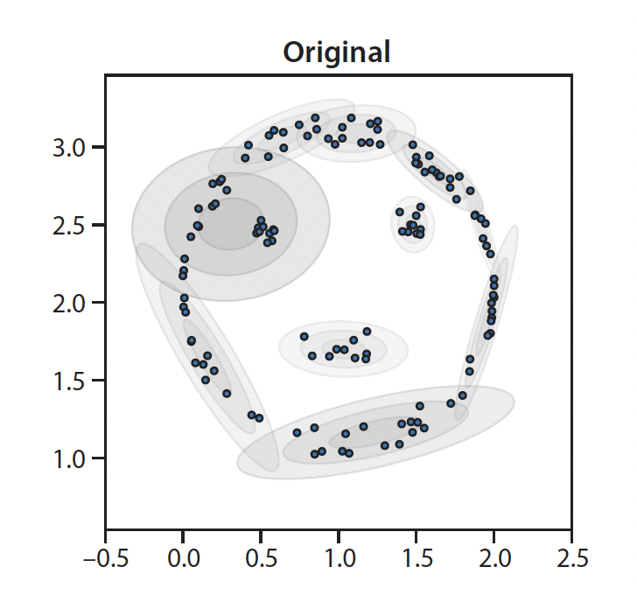
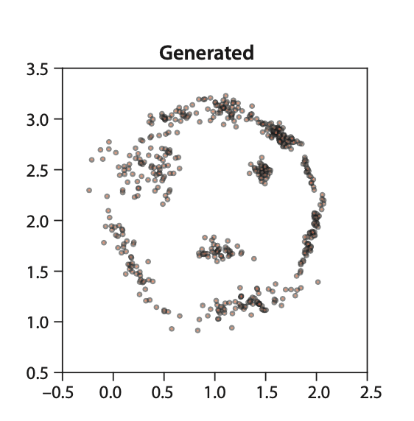
gaussian mixtures for smiley face

Slide 31
a quick dip into unsupervised learning: dimensionality reduction

Slide 32
Dimensionality reduction 101: pca
The goal of DR techniques is to learn lower dimensional representations of the data.
They are useful for visualization, data exploration, more efficient processing etc.
Principal Component Analysis is the simplest DR technique. Often good enough!
In linear PCA, we seek a small number of representative samples so that every element of our data set can be expressed as a linear combination of those elements, with the minimum possible MSE.

Slide 33
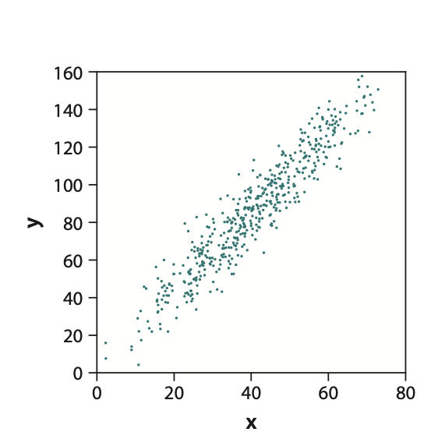
Linear pca
How many relevant dimensions in this data set?
How many coordinates needed in original (x,y) representation?

Slide 34
LINEAR PCA
If we rotate the representation, we might be able to reduce the dimensionality from 2 to 1
with minimal information loss.
In practice, this corresponds to finding the direction with maximum spread in the projection of data (variance) and repeating the process iteratively.
PC 2
PC 1

Slide 35
LINEAR pca
Principal Components (PC) are directions that capture most of the variance in the data.
First PC: direction of greatest variability in data; data points are most spread out when projected on the first PC, compared to any other direction
Second PC: next direction of greatest variability, orthogonal to first PC
Third PC: next direction of greatest variability, orthogonal to first and second PC
There are as many components as independent dimensions in the data
The additional information (variance) of the data decreases as we add PCs, so it’s up to us when to stop.

Slide 36
Math formulation
If data are centered (mean along each direction = 0),
one can show that :
- The PCs are the eigenvectors of the covariance matrix X^{T}X
of the data
- The ordering is given by the magnitude of the eigenvalues (first PC corresponds to largest eigenvalue etc)
- For centered data, the maximum-variance approach is equivalent to minimizing MSE of projection

Slide 37
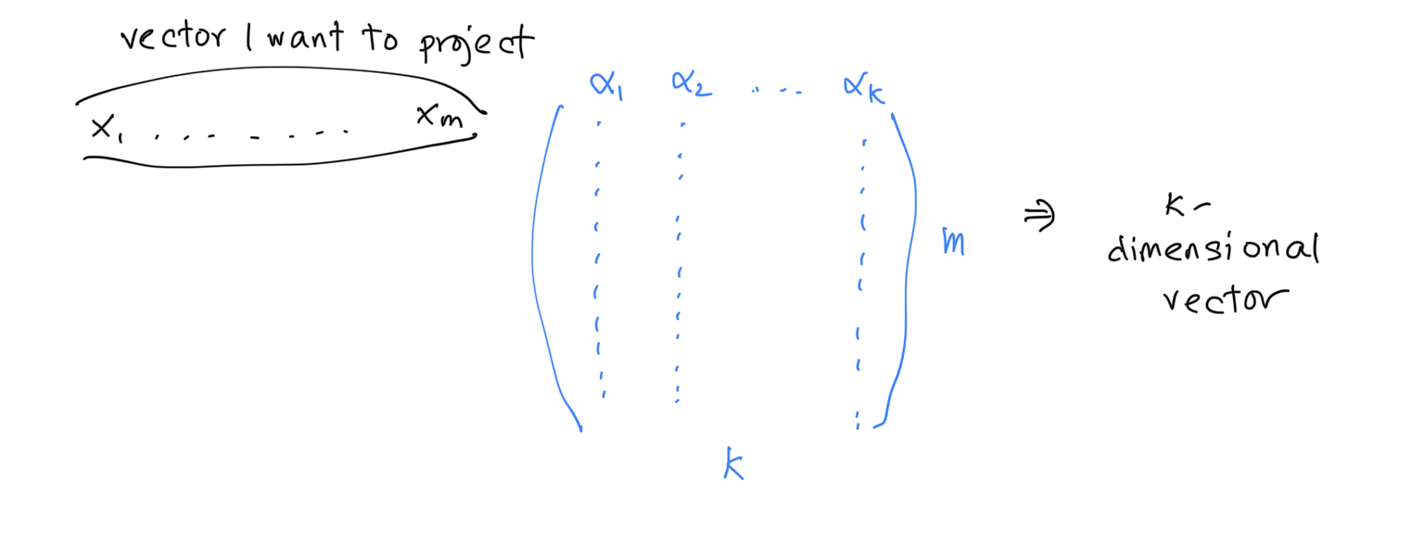
Pca projection
Once we have found and sorted the eigenvectors $αi$ , I can stack them together to find the projection matrix, which will have as many rows as the original data set dimension (m), and as many columns as I want to keep (k). The new representation is found by multiplying each data point (old or new) by the projection matrix.

Slide 38
What’s the dimensionality reduction?
If use K components for a data set with N instances and M features, I would now only save the PCA components (K objects with M features), and the K coefficients for each of the N objects.
For example, imagine that my original data set is made by
10,000 64 x 64 images.
M = 4096, N = 10,000.
The entire data set has size M * N ∼ 4∗10⁷.
If I can describe each image well enough as a superposition of - say - 20 eigen-images, the dimensionality of the new data set is 20 * 4096 (the feature values of each eigen-image) + 20*10,000 (the 20 coefficients for each of the original images) ~ 3 * 10⁵
K * M + K * N = K * (M+N)
<< M * N if K << M,N (I think?)

Slide 39
When does it work?
When there exist a lower-dimensional representation of the data, of course!
However, in high-dimensional data sets (e.g., images, spectra…) this is very common.

Slide 40
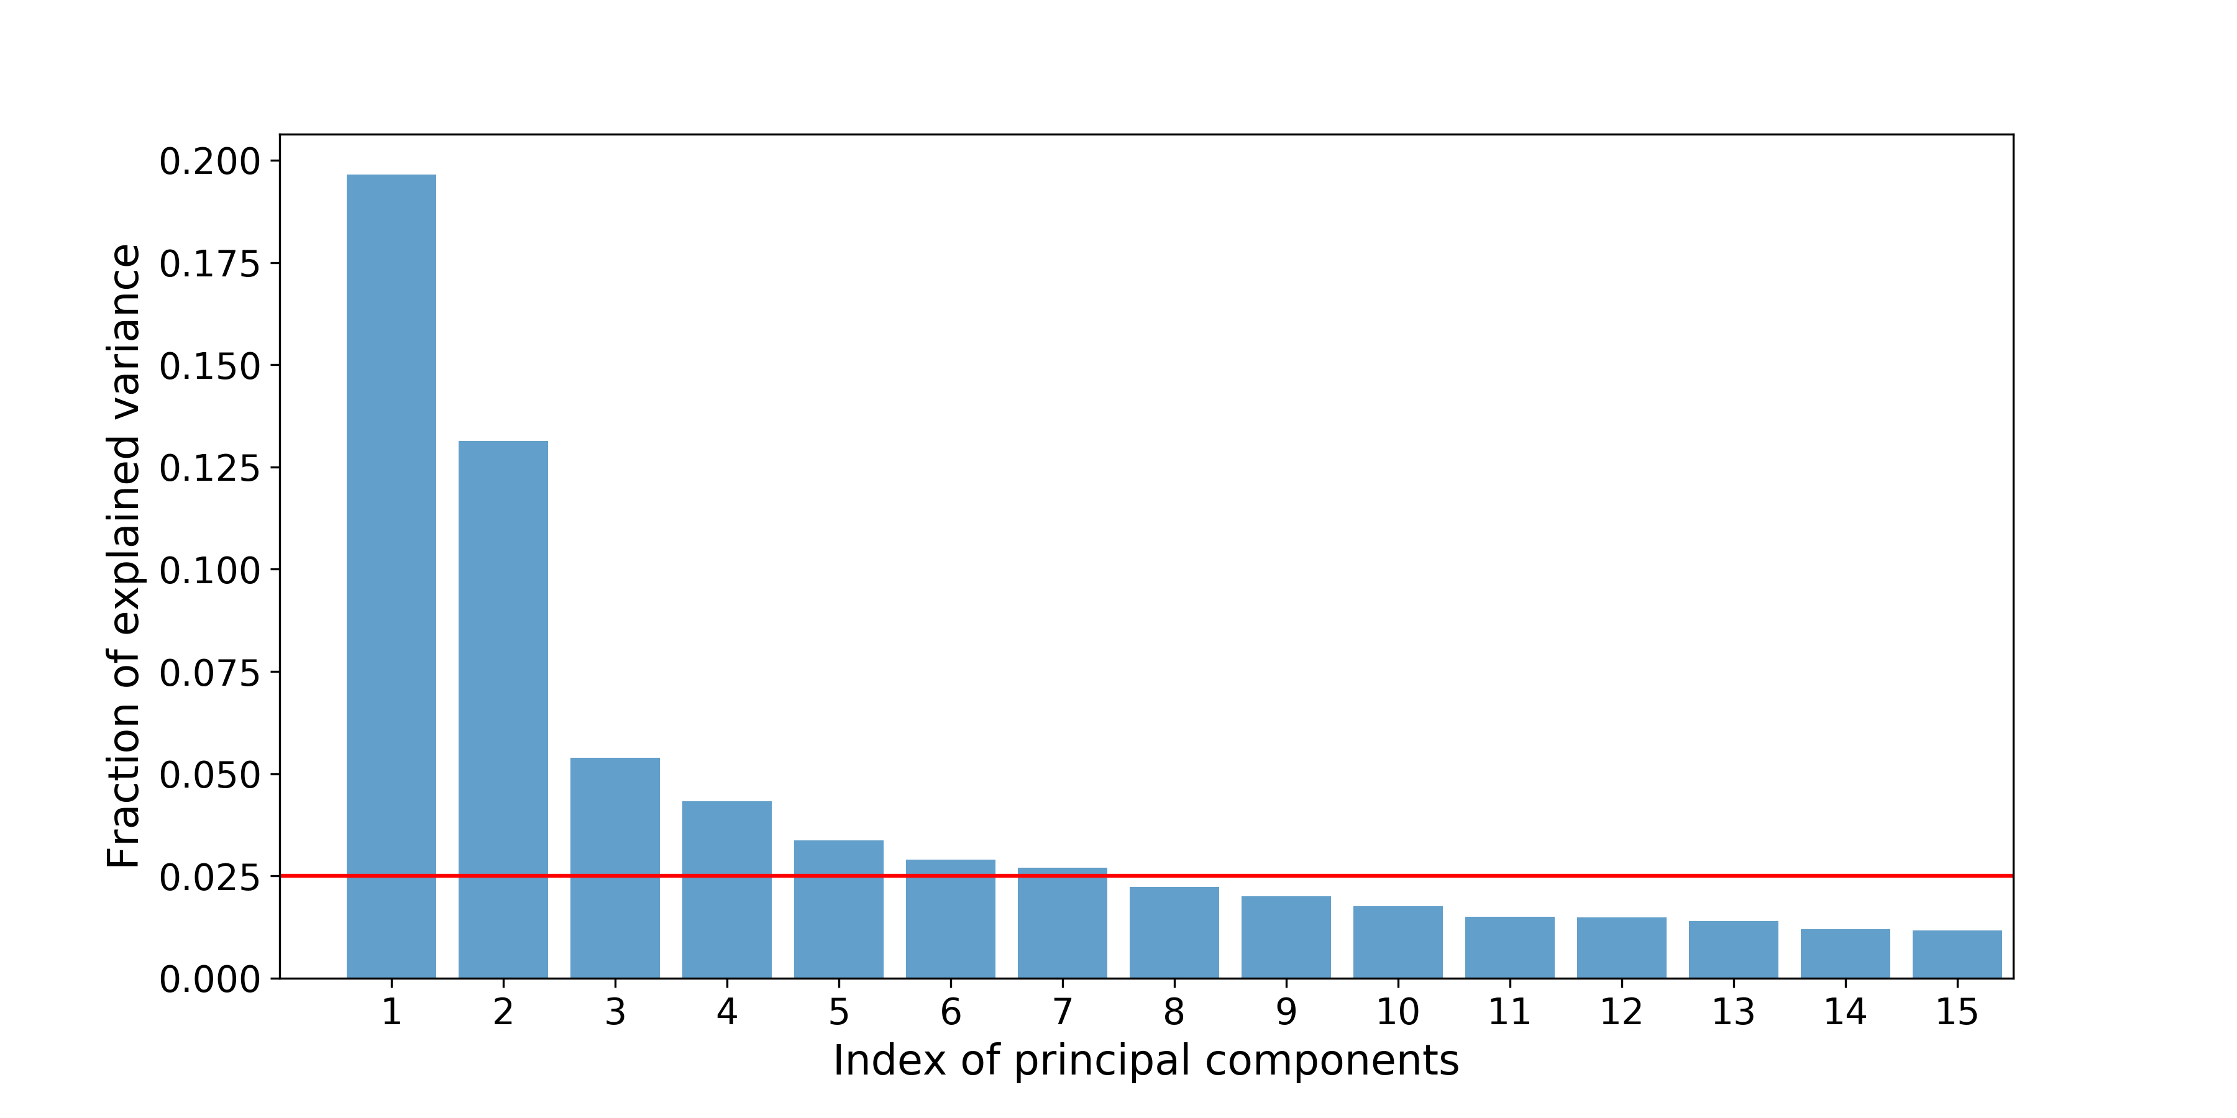
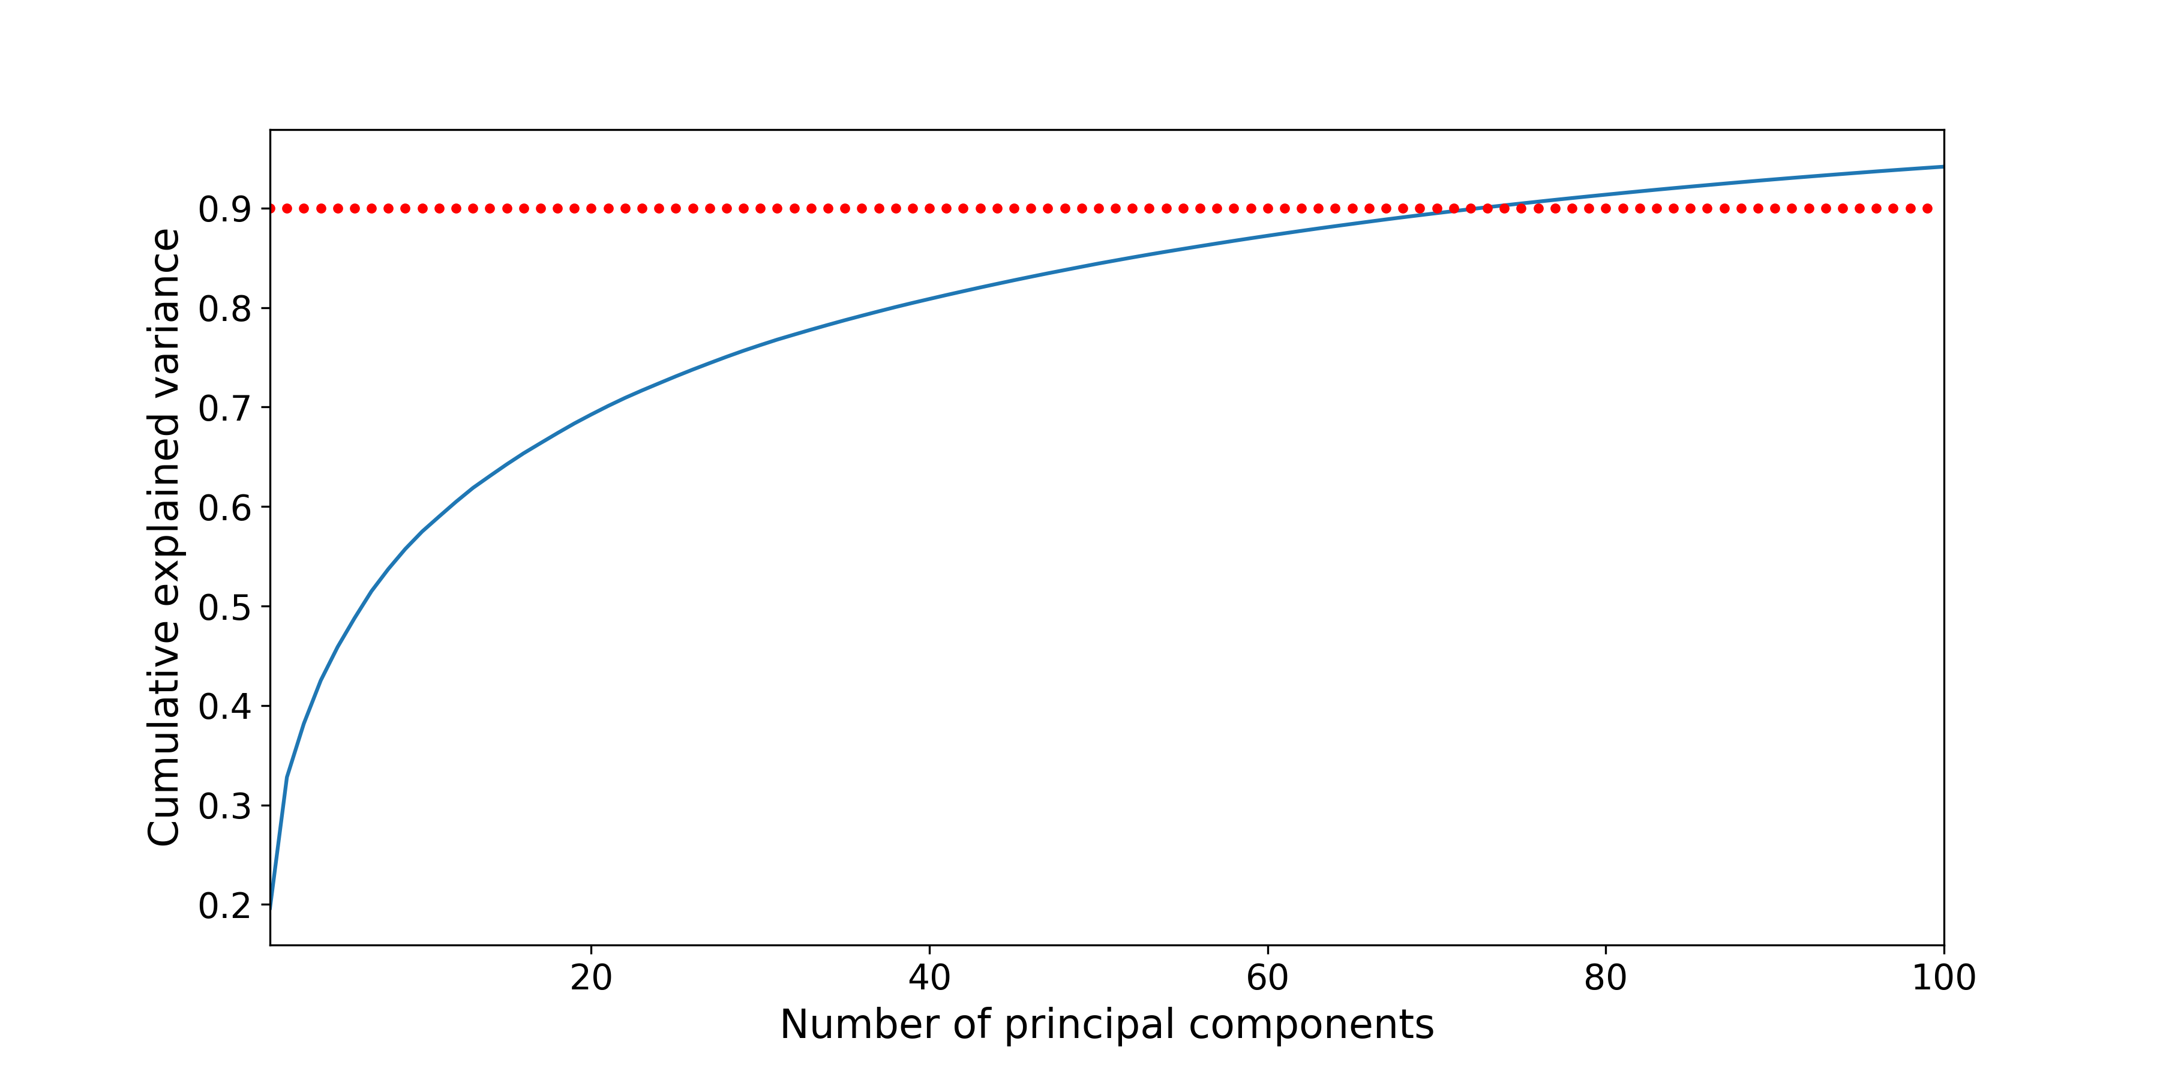
How do we assess information loss?
A typical approach is to create a PCA representation of the data and ask what fraction of the variability in the data is captured by a certain number of PCs.
We can exclude components that yield a small contribution to the total variance (left), or look at the cumulative explained variance and recover a fixed fraction (right).
We can also look at other metrics, e.g. the % error in reconstruction.

Slide 41
Kernel PCA
Remember our old friend, the kernel trick from SVMs?
Turns out that we can apply it here as well.
We can use a kernel function to obtain principal components in a transformed space, going beyond the linear representation, but without specifying the mapping function.
The principal components in kernel PCA are the eigenvectors of the kernel matrix ☺
They are not a linear mapping of the original features.

Slide 42
Kernel PCA
The original data, shown in the leftmost panel, live in two dimensions and allow us to distinguish between the two populations (characterized by different colors for illustration purposes). Linear PCA (second panel from left) can't engineer a transformation to a lower- dimensional space that keeps the information about population membership (i.e., color), but Kernel PCA can, provided that the correct value of γ is chosen.

Slide 43
How can we achieve dimensionality reduction?
PCA
Clustering
Lasso (Ridge) regularization
Feature ranking + selection from tree-based methods

